Slide 1
Introduction
Building Personal Websites
Lecture 01 | Introduction

Slide 2
Course Introduction & Logistics
Setting up GitHub Pages
Introduction to the HTML Structure
Building Personal Websites
Lecture 01 | Introduction

Slide 3
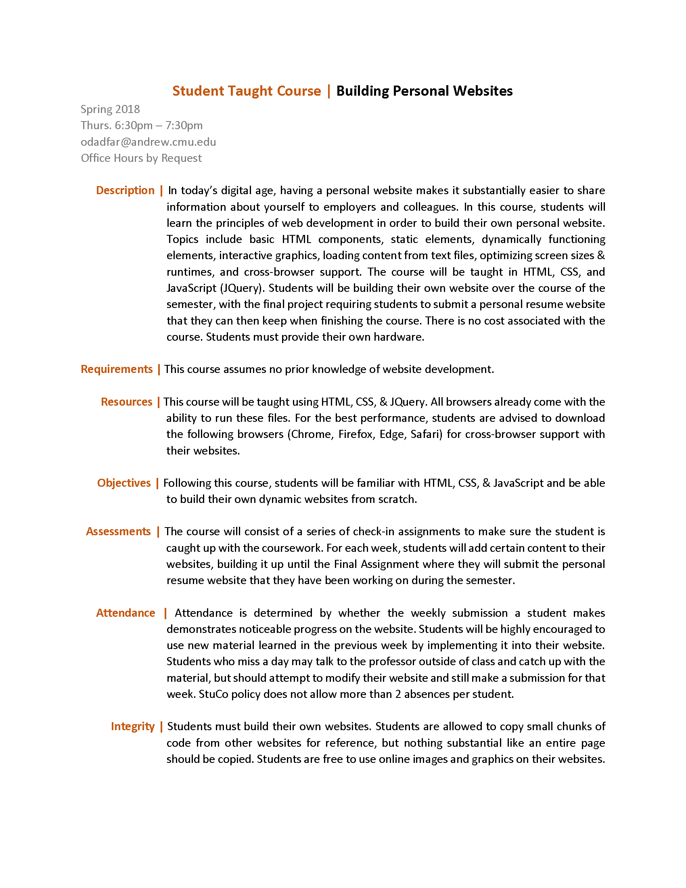
Syllabus Review
Building Personal Websites
Lecture 01 | Introduction

Slide 4
Main Points
This course assumes no prior knowledge of website development
Taught using HTML, CSS, & JQuery
Two Absences allowed by StuCo Policy
Short, fun polls to track attendance
Must provide own hardware
Each homework asks you to build upon your website with content from the most recent lecture
Lecture
Live Demo
Work Session
New Concepts
Examples
Ask Questions, Work on Site
Building Personal Websites
Lecture 01 | Introduction

Slide 5
Grading
Attendance
0 %
Paying Attention
0 %
Doing Homework
0 %
Reviewing Slides & Notes
0 %
Asking Meaningful Questions
0 %
Being Proud of the Site You Build
10000000000000000000000000000000000000000000000000000000000000000000000000000000000000000000000000000000000000000000000000 %
* To qualify for this, you must attend all but 2 lectures and commit updates to your site for all but 2 weeks
Building Personal Websites
Lecture 01 | Introduction

Slide 6
Goals
To develop a personal website (resume, portfolio, etc.)
Commit changes each week to GitHub Pages
Building Personal Websites
Lecture 01 | Introduction

Slide 7
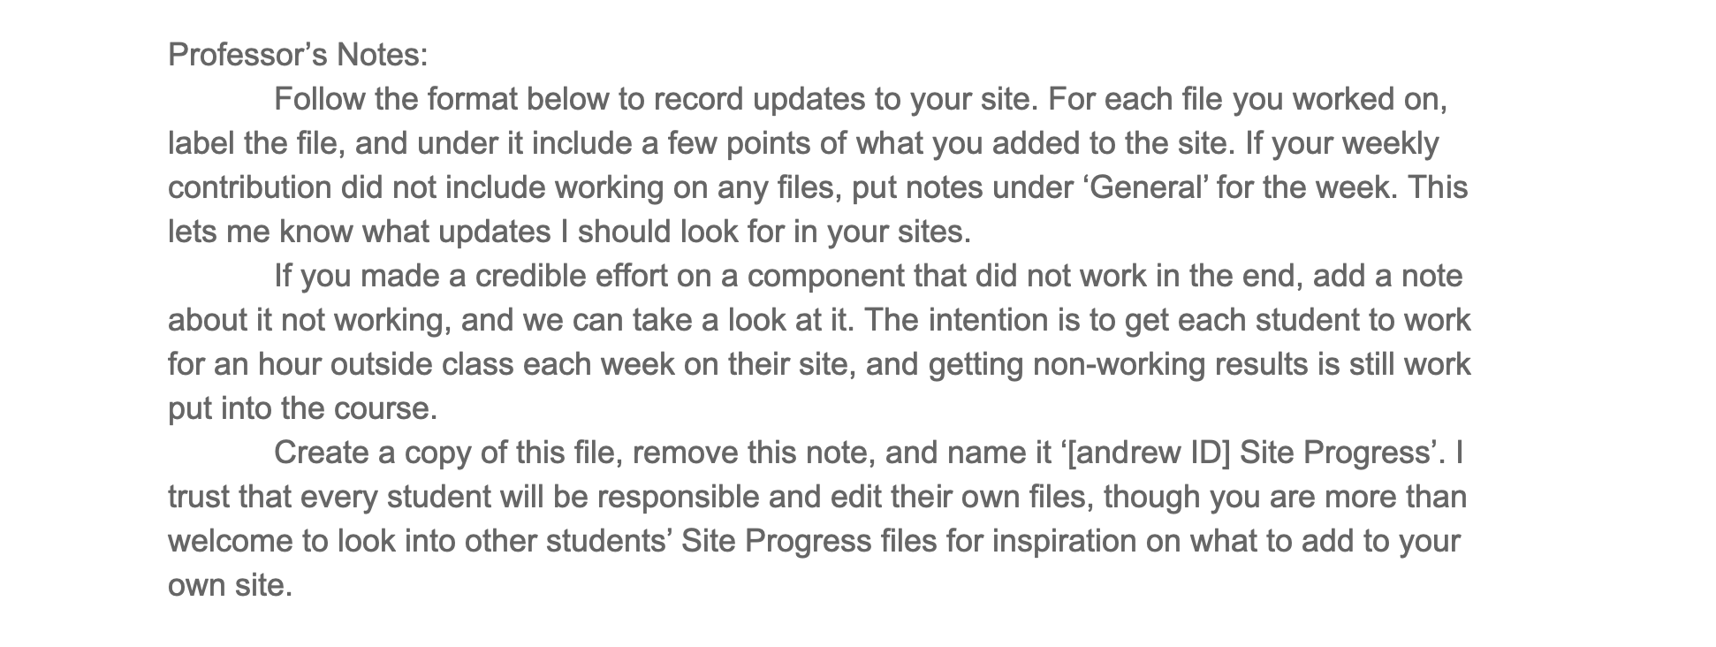
Site Progress Log
Google Doc listing what files you updated per week.
Helps find what changes made to site.
Building Personal Websites
Lecture 01 | Introduction

Slide 8
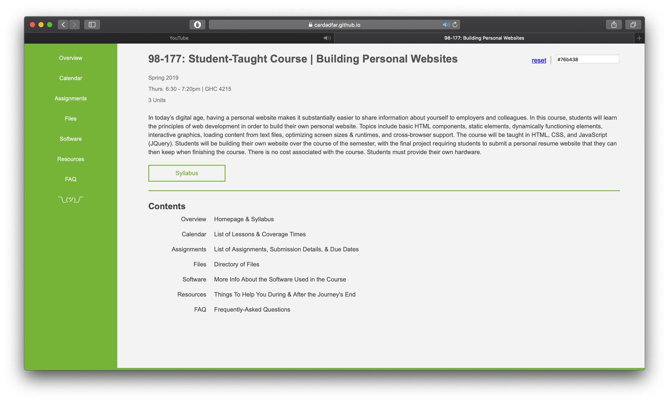
Course Webpage
https://tinyurl.com/stuco-bpw
* bookmark this *
Building Personal Websites
Lecture 01 | Introduction

Slide 9
Building Personal Websites
Lecture 01 | Introduction

Slide 10
What You Will Need
Browsers (To test on different platforms)
Chrome
Safari (Mac only)
Edge
Firefox (People still use this)
Text Editors
Sublime
Notepad (For the brave)
Software
HTML & CSS (Integrated in browsers)
JQuery (Will discuss later)
WEAN & CFA Clusters have iMacs with Safari
Building Personal Websites
Lecture 01 | Introduction

Slide 11
Course Introduction & Logistics
Setting up GitHub Pages
Introduction to the HTML Structure
Building Personal Websites
Lecture 01 | Introduction

Slide 12
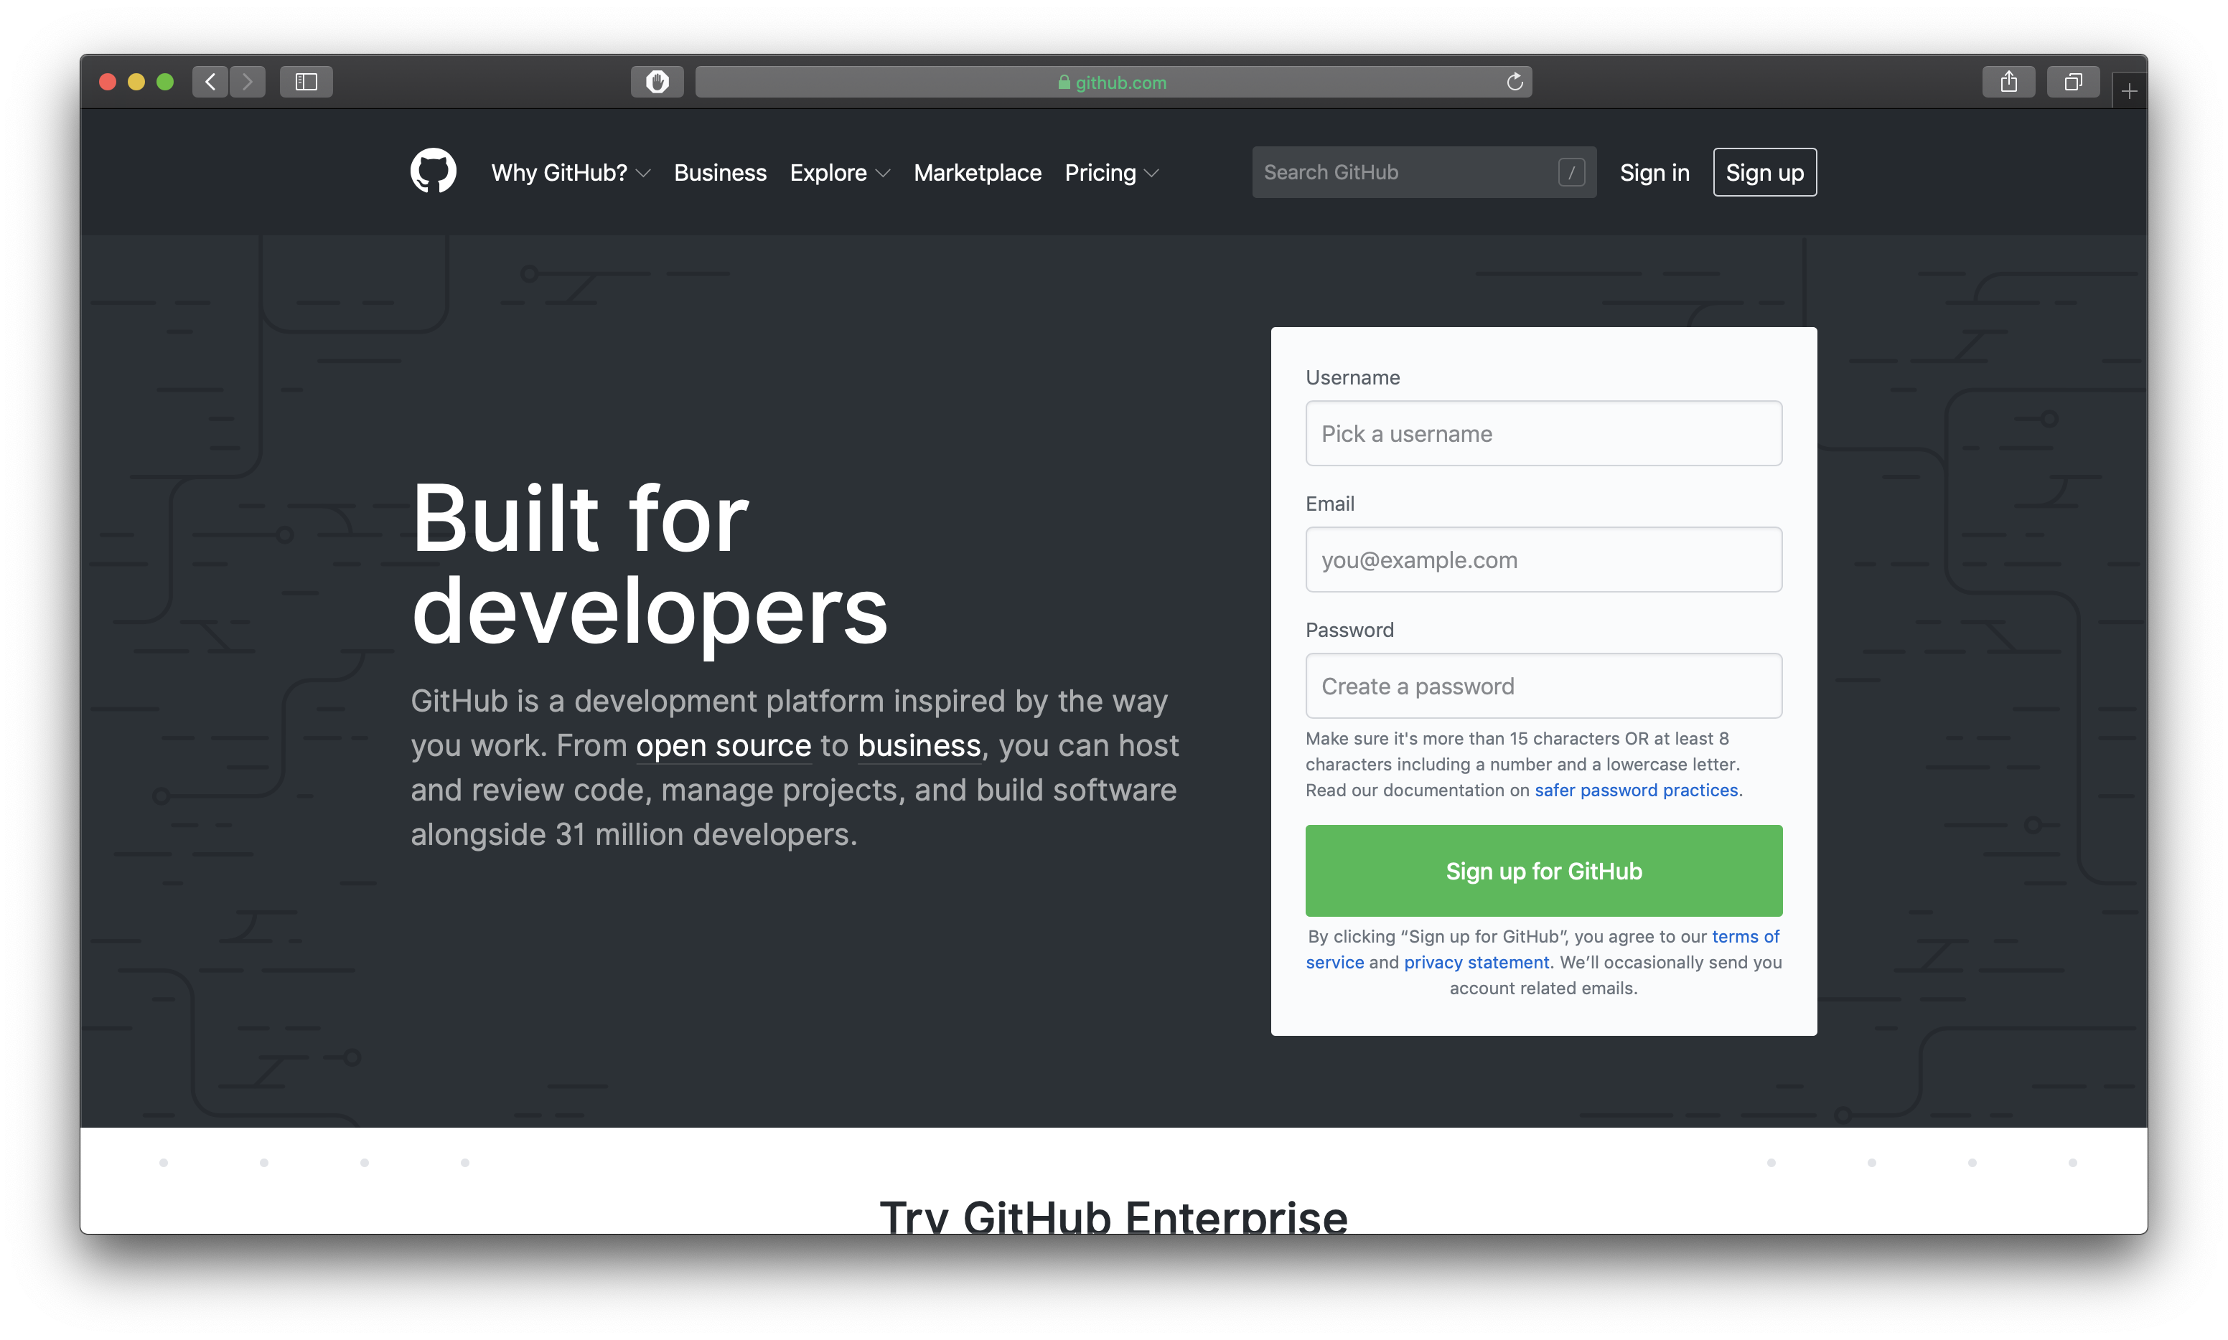
Create a free GitHub account
Building Personal Websites
Lecture 01 | Introduction

Slide 13
Create a live page for your site
Upload files from your computer
Building Personal Websites
Lecture 01 | Introduction

Slide 14
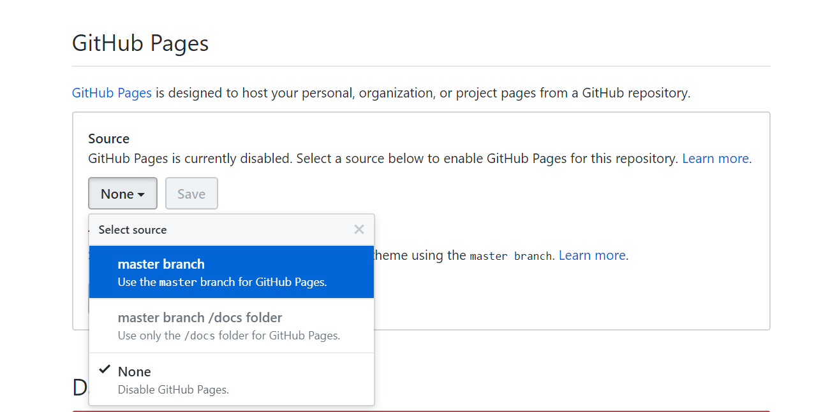
Make sure to have an index.html file as the homepage.
This is what GitHub Pages looks for to start at.
Building Personal Websites
Lecture 01 | Introduction

Slide 15
Clone repository to a local directory.
Any changes you make to that directory can be uploaded back to GitHub.
Building Personal Websites
Lecture 01 | Introduction

Slide 16
Pushing Changes to GitHub
Add files to a queue ready to be pushed
git add ‘filename’
To add all files in current directory
git add .
Add a commit message (good place to mention what you’ve changed)
git commit -m ‘public commit message’
Push changes
git push
Building Personal Websites
Lecture 01 | Introduction

Slide 17
Course Introduction & Logistics
Setting up GitHub Pages
Introduction to the HTML Structure
Building Personal Websites
Lecture 01 | Introduction

Slide 18
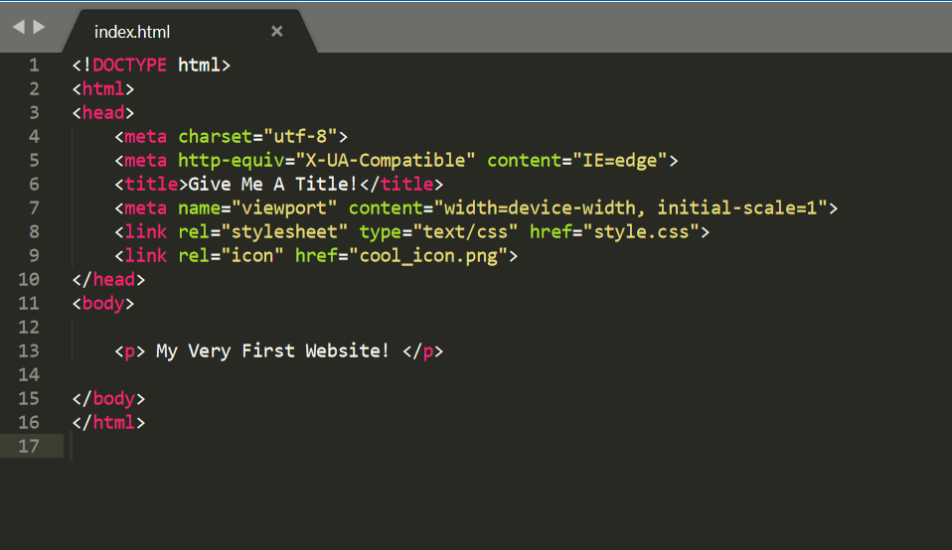
HTML Structure
HTML comes in Tag:Content pairs
< tag content=“content” >
< tag > content </ tag >
The type of tag dictates what form it is
source | html_starter.html
Building Personal Websites
Lecture 01 | Introduction

Slide 19
HTML Structure
< html >
< head >
< meta … >
< title > …. </ title >
< link … >
</ head >
< body >
< p > … </ p >
</ body >
</ html >
source | html_starter.html
Building Personal Websites
Lecture 01 | Introduction

Slide 20
Homework Ideas
Every week I will give you recommendations on what to work on to update your site.
Recommendations will usually be made based on the topics most recently taught.
You do not have to implement recommendations, choose what you want to do.
Building Personal Websites
Lecture 01 | Introduction

Slide 21
Homework Ideas
This week for homework, everyone must do the following:
Bookmark the course website.
Download Sublime (or other text editor), and Chrome, Firefox, Edge, and Safari (Mac Only)
Create a GitHub account (if not already).
Create a new repository for your website.
Include a new index.html file with the html_starter.html code on the course website.
Clone your repository to a local directory.
Make a Git Page from your repository.
Send an email to Andrew ID odadfar with your Andrew ID and a link to your published site.
Create your own Site Progress Log doc on the shared course Drive (duplicate template).
Add the above fields to your Week 01 Progress Log entry.
Building Personal Websites
Lecture 01 | Introduction

Slide 22
Live Demo
Building Personal Websites
Lecture 01 | Introduction

